Slide 1

Health & Wellness resources
By: Jaimie Rainville, Trent University Student placement
Completed for: ELQI

Slide 2
Overview of project
Complex roles & responsibilities of educators
Impact of stress & Burnout
Burnout stages, signs & symptoms
Statistics within your community
Well-being resources
Belonging resources
Engagement resources
Expression resources
Other resources (free & paid)
Kawartha Lakes & Haliburton mental health crisis resources
Finding the right counsellor
Advice from other educators in your community

Slide 3
Educators have complex Roles & Responsibilities
“As part of the broader early years system, what you do every day has a lasting impact on children’s learning, development, health, & well-being as they grow & mature in your program”
Although educators play an important role in the success of children, they are often understaffed & underpaid, which leads to increased levels of stress & unfavorable working conditions (Irvine et al., 2016)
In a survey of 2,300 ECEs, mental health challenges & burnout were reported by 45% of respondents & insufficient staffing levels were reported by 43% of respondents (Modan, 2022)
Limited time to address the needs of children can expend resources & prevent educators from meeting their professional responsibilities which decreases satisfaction rates (Gupta & Simonsen, 2017).

Slide 4

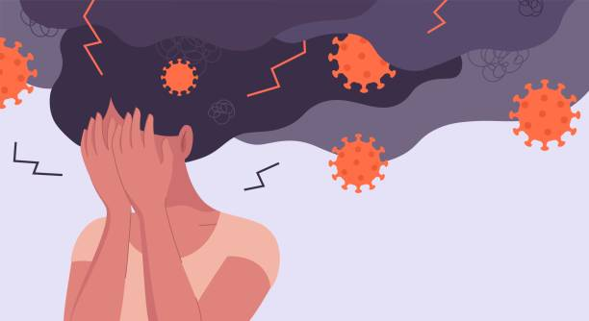
Impact of stress & burnout
Work-related burnout has been increasing over the years (Precker, 2022)
Occurs when an individual’s efforts & coping mechanisms are not enough to combat work related stressors (Gupta & Simonsen, 2017)
WHO defines burnout as “feeling depleted, exhausted, mentally distant or cynical about one’s job, with reduced competence & effectiveness at work” (Precker, 2022)
Health Implications: Linked to increased cholesterol levels, increased blood pressure, depression, insomnia, coronary heart disease, diabetes, & unhealthy behaviours such as smoking, alcohol & inadequate sleeping patterns, among others (Precker, 2022)
Prevention & early recognition is key!
  Get to know your “normal” & the potential signs/symptoms of burnout

Slide 5
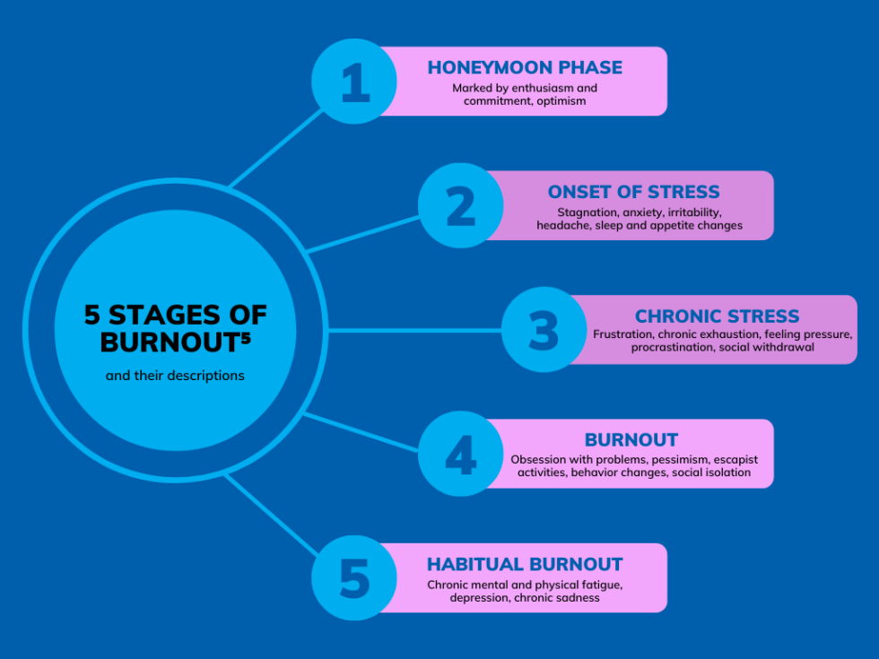
Stages, Signs & symptoms
Feeling tired/low energy
Inability to cope with stressors
Neglecting self-care
Trouble with falling asleep or staying asleep
Changes in emotions (sad, angry, irritable, etc)
Difficulty focusing
Feelings of doubt or feeling let down
Use of alcohol & other substances
Getting sick more than usual
Overall “feeling off”
Having headaches, stomach aches or other physical complaints with no known cause
Incidence of heart disease, high blood pressure or T2 diabetes
(Mayo Clinic, 2021)

Slide 6
You are not alone!
79.5% of educators were experiencing a current stress level between 5-10 (0-10 scale) with the avg~7-8
85.3% stated that their job has led to burnout at some point
Some of the main contributing factors included: high workload, managing children’s behavior, administrative tasks, lack of resources/support, parent expectations, long working hours, & low pay, among others
35.3% of educators were not aware of any mental health or wellness resources in their community & of those who were aware of resources, 76.5% have not used them (cost, time constraints, location, stigmas, lack of awareness, etc)

Slide 7
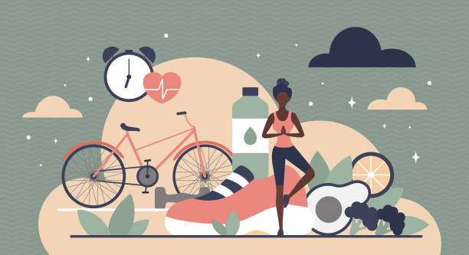
Well-being
Centre for Addiction & Mental Health (CAMH) Resources for Teachers & Educators (online) - Offers mental health tools & resources designed to help educators manage stress, anxiety, & burnout. Provides guides, articles, & workshops.
Canadian Mental Health Association (CMHA) - Haliburton, Kawartha, Pine Ridge Branch -
Free counseling, peer support, mental health resources, & wellness programs. They also offer workshops on stress management and coping strategies.

Slide 8
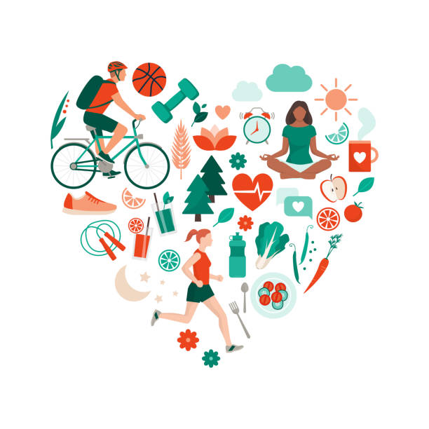
Well-being
Mind Beacon (now part of CloudMD) –
Provides free guided therapy for Ontario residents. Offers cognitive behavioral therapy (CBT) tools and resources for anxiety, stress, and burnout.
BounceBack Ontario –
Free, guided self-help program for adults dealing with low mood, stress, & anxiety. Provides telephone coaching and access to online videos.
ConnexOntario –
Free 24/7 access to healthcare services information. Reach out at any time via phone, text, live chat, or email. Explore a directory of mental health services & programs or utilize screening tools for mental health & addiction.

Slide 9


Well-being apps
MyFitnessPal–
This app is free with in-app purchases. Includes a calorie counter & nutrition tracker. Has a feature that allows you to take a picture of any meal and provides instant nutritional feedback. Personalizes goals on the dashboard, allows you to scan barcodes at the grocery store & will provide feedback on that item allowing for more informed decisions for you to take control of your nutrition. Tracks carbs, proteins, fats, etc. Also provides personalized recipes tailored to you. This app also allows you to join an online community allowing for support.
StressWatch –
This app includes an AI Stress Monitor. It is free (upgrade with in-app purchases). Provides suggestions for healthy habits and stress relief, better understand of your sleep patterns & also provides feedback, such as duration and quality. This app also allows you to easily track your mood, water, & caffeine intake. Option to pair your apple watch if you have one and it will track your heart rate patterns over time, & measure real-time heart rate stress levels, alerting you when it is too high.

Slide 10


Belonging
Curve Lake First Nation – Offers spiritual and cultural ceremonies led by Indigenous elders, including smudging and healing circles.
Camebridge Street United Church – Lindsay, ON – Hosts spiritual gatherings, prayer services, meditation practices, and other events as posted on their website.
Anishnaabe Spiritual Centre – A place for spiritual nourishment, enlightenment, growth and healing. Offers workshops on Indigenous spiritual practices and ceremonies for healing and community building.
Canadian Association for Spiritual Care – Leading association of spiritual care and psychospiritual therapy in Canada, embracing a holistic approach to well-being with a focus on spiritual and religious care. While some services come with a fee, there are also many events and resources listed for free on their website.
Seeds of Wisdom (Formally Sacred Fire Foundation) – Provides virtual teachings and ceremonies to support Indigenous spiritual growth and healing.

Slide 11


belonging
Kawartha Lakes Pride – Check out their Facebook & Instagram page and connect with other LGBTQ2S+ community members and allies in your area.
Pflagcanada – Volunteer run & offers peer-to-peer support, education, resources & events. Visit the website and click on Lindsay- Kawartha Lakes to find contact information
New Canadians Centre Peterborough – Connects new Canadians to services and programs to support this transition.
Farmer Wellness Initiative (Agriculture Wellness Ontario) – Access free, unlimited counselling for farmers, farm families, farm employees

Slide 12

Early Learning Quality Initiative and Travelling Tales Libraries/BLOG – The ELQI and Travelling Tales Libraries have more than 1600 resources available to borrow at no cost for educators working in our local community. ELQI Library resources focus on materials for educators to support their work and practice while the Travelling Tales Library is a collection of inclusive children's books. Educators can borrow up to 10 resources from each library and most materials are on loan for 60 days. Check out the ELQI blog for more information & resources.
Kawartha Lakes Public Library - Offers community passes for local attractions & Ontario Parks, as well as active living resources (disc golf sets, birding kits, soccer sets, adventure kits, etc). Also an opportunity to get outside with “Storywalks”: Pages of a book are stationed around a trail, pairing literacy with physical activity. Available at Ken Reid Conservation area (Lindsay), Kawartha Settlers’ Village (Bobcaygeon) & all over Kawartha Lakes on a regular basis. Check the events calendar on their website for other upcoming events. There are also many health and wellness books for a healthy you available at the Library.
Engagement

Slide 13
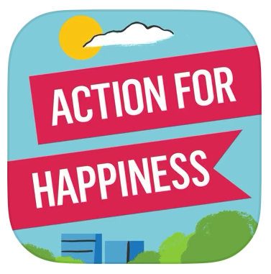


Yoga with Adriene - Free yoga sessions designed to reduce stress and improve mental well-being. Accessible for beginners and offers targeted routines for stress relief.
Action for Happiness: Get tips App
This is a free app that will prompt you with simple action ideas each day to support your well-being & spread happiness to others. It allows you to join a self-care community that will boost happiness & positivity for yourself & others. Each month’s prompts are different & research based.
Insight Timer- Meditate, Sleep App
This is the most used free meditation app (some in-app purchases). It allows you to meditate with a large global library of well-being content. This app includes breathwork practices, live yoga each day, challenges such as setting boundaries, you can plan & create a routine suited to your needs, & it also enhances sleep & focus, while reducing stress. The best thing about this app is that there is a wide range of lessons suitable to your busy schedule from just a few minutes to long sessions.
Engagement (online)

Slide 14



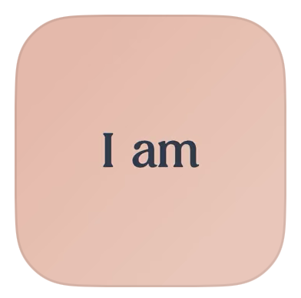
AllTrails App:
Hike, Bike & Run- Discover over 45,000 trails, view the trails beforehand & plan your trip. Includes recent photos, distances, reviews, option to track your progress (GPS style), & sends location updates & notifies you if you’ve gone off course. Also allows for personalization (i.e difficulty level, waterfalls, dog-friendly, etc).
Finch: Self-Care Pet App:
Self care pet app that is free (some in-app purchases) & helps you feel prepared & positive each day- When you take care of yourself you take care of the pet. This app makes self-care rewarding & fun, allowing you to choose from different personalized self-care exercises. It offers goal setting, meditation, mindful exercises & journaling, among other features.
Expression
Halo App:
Daily Self Care Journal- Allows you to declutter your mind weather you have 5 mins or 50mins. Includes prompts every day, such as “how are you feeling?” & “what are you grateful for?”. Provides feedback on mood distribution over time and influences on what makes you feel good. Completely confidential, private & secure. Provides a library of resources on topics such as personal growth & self love. Also has a neat feature where you can audio record journal messages for those who do not enjoy writing. Allows you to review your day and identify potential triggers.
I am- Daily Affirmations App:
A free app (some in-app purchases) that helps you to reroute negative thoughts & build self esteem. Helps you to center your goals and intentions with your dreams & ambitions. Strengthening the connection between your conscious & unconscious mind builds resiliency, allowing you to better tackle challenges that arise. This app will also allow you to increase self-awareness and recognize self-doubting thought patterns. Also comes with personalized widgets and themes to help you get inspired.

Slide 15
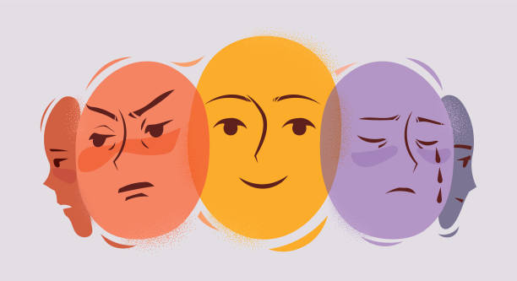
Expressive activities
Challenge: Artistic Expression:
On a sketch pad choose a prompt below to express how you are currently feeling:
Draw something that makes you feel happy/motivated
Draw how you are feeling right now
Draw something that you resent & then turn it into something beautiful

Slide 16
Other resources
Webinar (January 22, 2025):
  Beth Cannon
  “The Link to Stability When You’re on the Brink of Burnout”
  See handout for link
Website to support burnout, chronic stress, & mental health, among other supports:
  Search, filter & find articles, audios, books, videos, & courses tailored to your needs
  See handout for link

Slide 17
Other (paid) resources
Calm App - Paid meditation and relaxation app designed to help reduce stress, promote sleep, and improve mental well-being.
  Cost: $76.99 CAD annually (after a free trial).
  Location: App Store
Headspace App - Paid mindfulness and meditation app. Offers guided meditation, sleep support, stress relief, and emotional regulation tools.
  Cost: $69.99 CAD annually (after a free trial).
  Location: App Store
The Association of Early Childhood Educators of Ontario (AECEO) - Some free professional online learning resources (paid membership for increased access to resources)

Slide 18
Kawartha lakes & Haliburton mental health crisis resources
  Telehealth: 1-866-797-0000
  Four County Crisis 24 hours: 1-866-995-9933
  Anishnaabe Kwewag Gamin Crisis Line: 1-800-388-5171 or 905-352-3708
  Social services in your community: 211
  Canopy Support Services (APS): 1-888-616-3456
  Kawartha Haliburton Victim Services: 1-800-574-4401
  Development Services of Ontario: 1-877-376-4674 ext. 212
  Kawartha Sexual Assault Centre: 1-866-298-7778
  RMH Mental Health Intake: 705-328-6064
  John Howard Society: 705-328-0472
  Women’s Resources of Kawartha Lakes: 705-878-5938
  YWCA Peterborough Haliburton: 1-800-461-7656

Slide 19
Finding the right counsellor
Connect with your healthcare provider
Speak with your employer to inquire about benefits & EAP’s
Psychology Today- connects you to counsellors based on location and needs has filters and has good articles and preferences- cost, sexuality, faith, gender, etc

Slide 20
Advice from other educators in your community
“Focus on positives and be solution focused”
“Find someone that you can trust, can confide in and rant to when needed”
“Plan and engage in activities that you enjoy so that you can really turn your brain off from work”
“Take time for yourself to disconnect from work… Take ALL of your vacation time”
“Reach out for support, don’t deal with it alone”
“Slow down, advocate for yourself, work as a team, discuss and problem solve concerns, make time for yourself”
“Remember to breathe”
“You are not alone! In order to take care of others we need to take care of ourselves first!”
“Learn to prioritise your needs and find the joy in your day”
“Take deep breaths, keep on singing keep on dancing”
“Find your balance”
“Don’t take on too much and take things one thing at a time. If you need a day off take it”
“take the time to recharge”
“Be kind to yourself… it’s ok to ask for help”
“Wake up each morning knowing it’s going to be a successful day. Work hard play harder”
“Remember why you started in this field. Remember the children who we are supporting”
“Look for the good in every single person you meet”

Slide 21
Activity!
Lets access some resources!
What resources would you be interested in learning more about tonight?
Are there any resources that you didn’t like or think would be irrelevant to this project?

Slide 22

Your feedback is appreciated
What are some areas of strength?
What are some areas of improvement?
Do you have any additional comments?

Slide 23
references
Gupta, N. D., & Simonsen, M. (2017). Non-cognitive child outcomes and universal high quality child care. Canadian Journal of Economics/Revue Canadienne D'économique, 50(2), 653-680. https://doi.org/10.1177/0829573516685017
Irvine, S., Sumsion, J., Lunn, J., & Thorpe, K. (2016, June 22). One in five early childhood educators plan to leave the profession. Childcare Canada. https://childcarecanada.org/documents/child-care-news/16/06/one-five-early-childhood-educators-plan-leave-profession
Mayo Clinic. (2021, June 5). Job burnout: How to spot it and take action. Mayo Clinic. https://www.mayoclinic.org/healthy-lifestyle/adult-health/in-depth/burnout/art-20046642
Modan, N. (2022, October 10). 45% of early childhood educators report high burnout, stress. K-12 Dive. https://www.k12dive.com/news/early-childhood-educators-experiencing-high-burnout-stress/633709/
Precker, M. (2022, October 12). How job burnout can hurt your health – and what to do about it. American Heart Association. https://www.heart.org/en/news/2022/10/12/how-job-burnout-can-hurt-your-health-and-what-to-do-about-it

